Slide 1
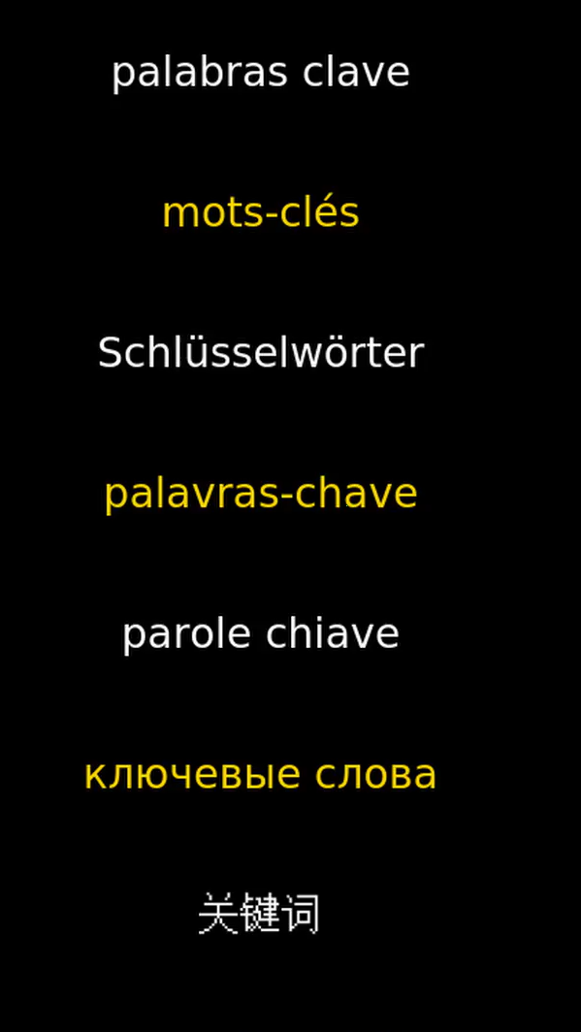
30 years of Keyness
University of Liverpool
22 June 2026
Mike Scott

Slide 2
Outline
The nature of –ness
How and why keyness emerged
Current corpus work using keyness

Slide 3
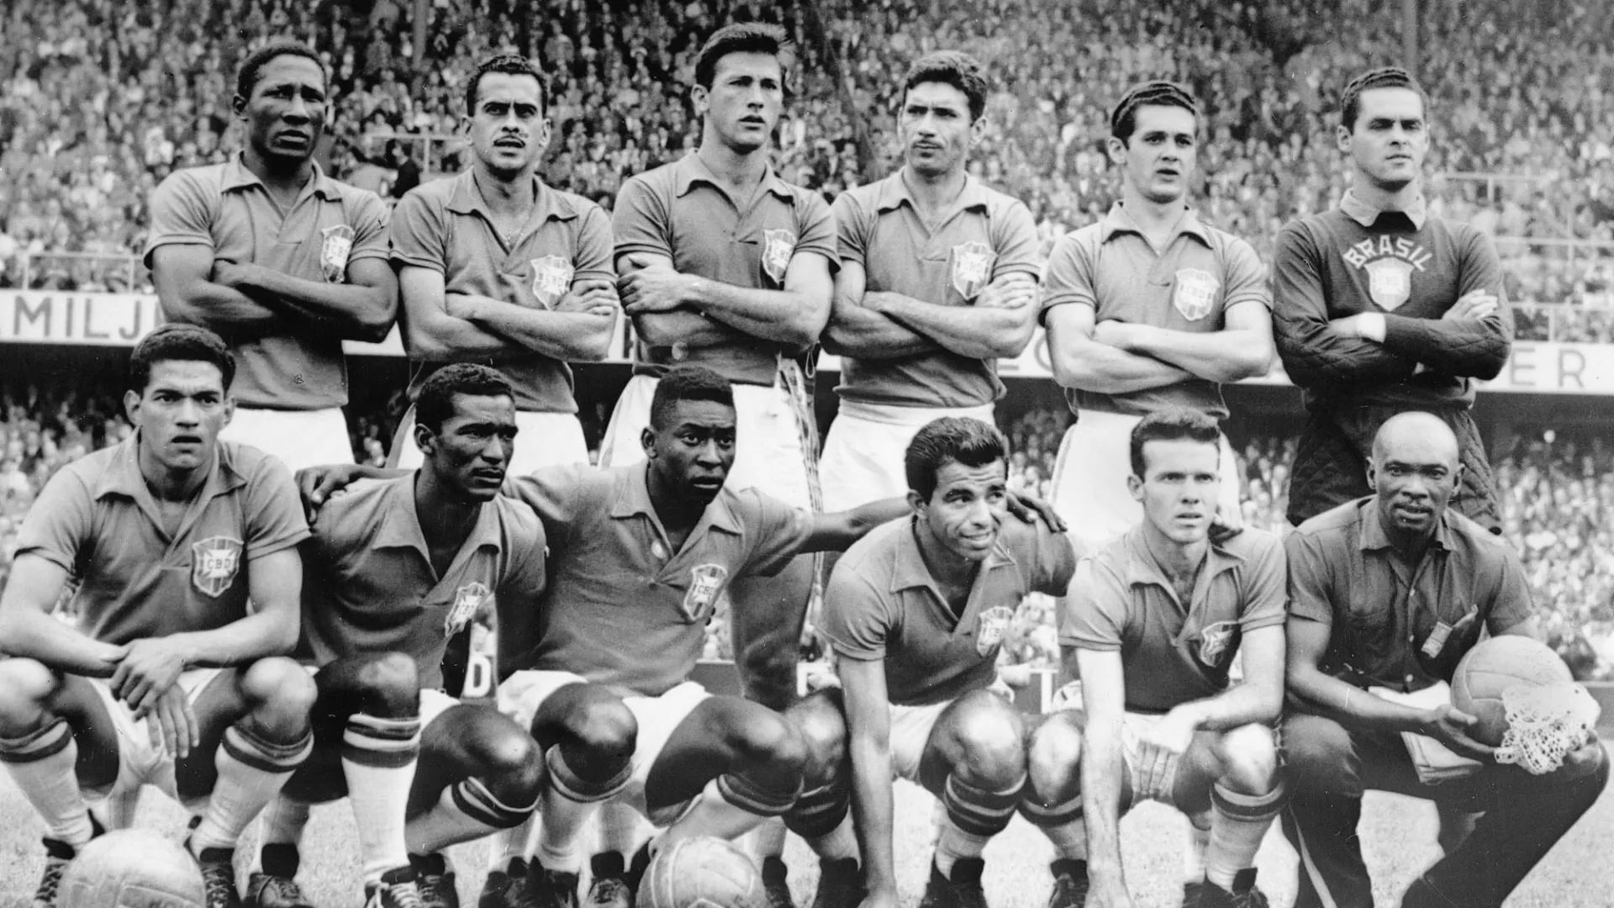
…but first
learning a language in the late 1950s
grammar-translation

Slide 4
The nature of -ness
a highly productive suffix
  Biermeier 2024
implies a scale
if unusual or nonce word, quotation marks

Slide 5
Biermeier
In IndE, there are seven examples of unlisted formations: for example, passportlessness, shockness, crimeproneness […], Punjabiness (3), […] man-whoreness and hard-to-accept-ness. Likewise, SingE contains ample evidence of abstract nouns in -ness: for example, gungho-ness […], shiokness […], tear-jerkingness (2) and Kawaii-ness.

Slide 6
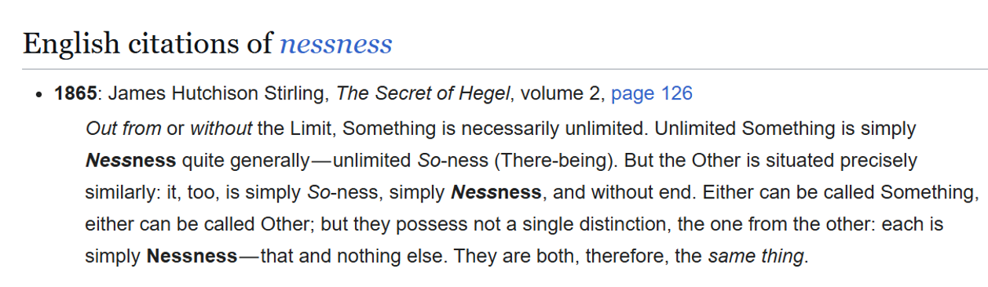
Wiktionary: nessness

Slide 7
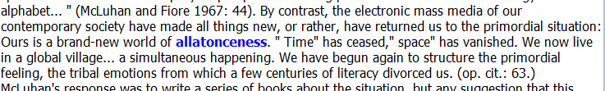
BNC World edition (section acad polit law edu) EW7.txt

Slide 8
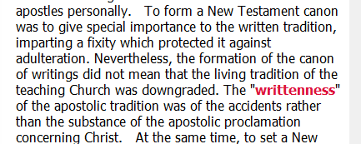
BNC World edition (section non ac humanities arts) ADC.txt

Slide 9
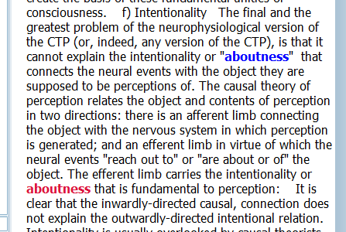
BNC World edition (section ac humanities) A0T.txt

Slide 10
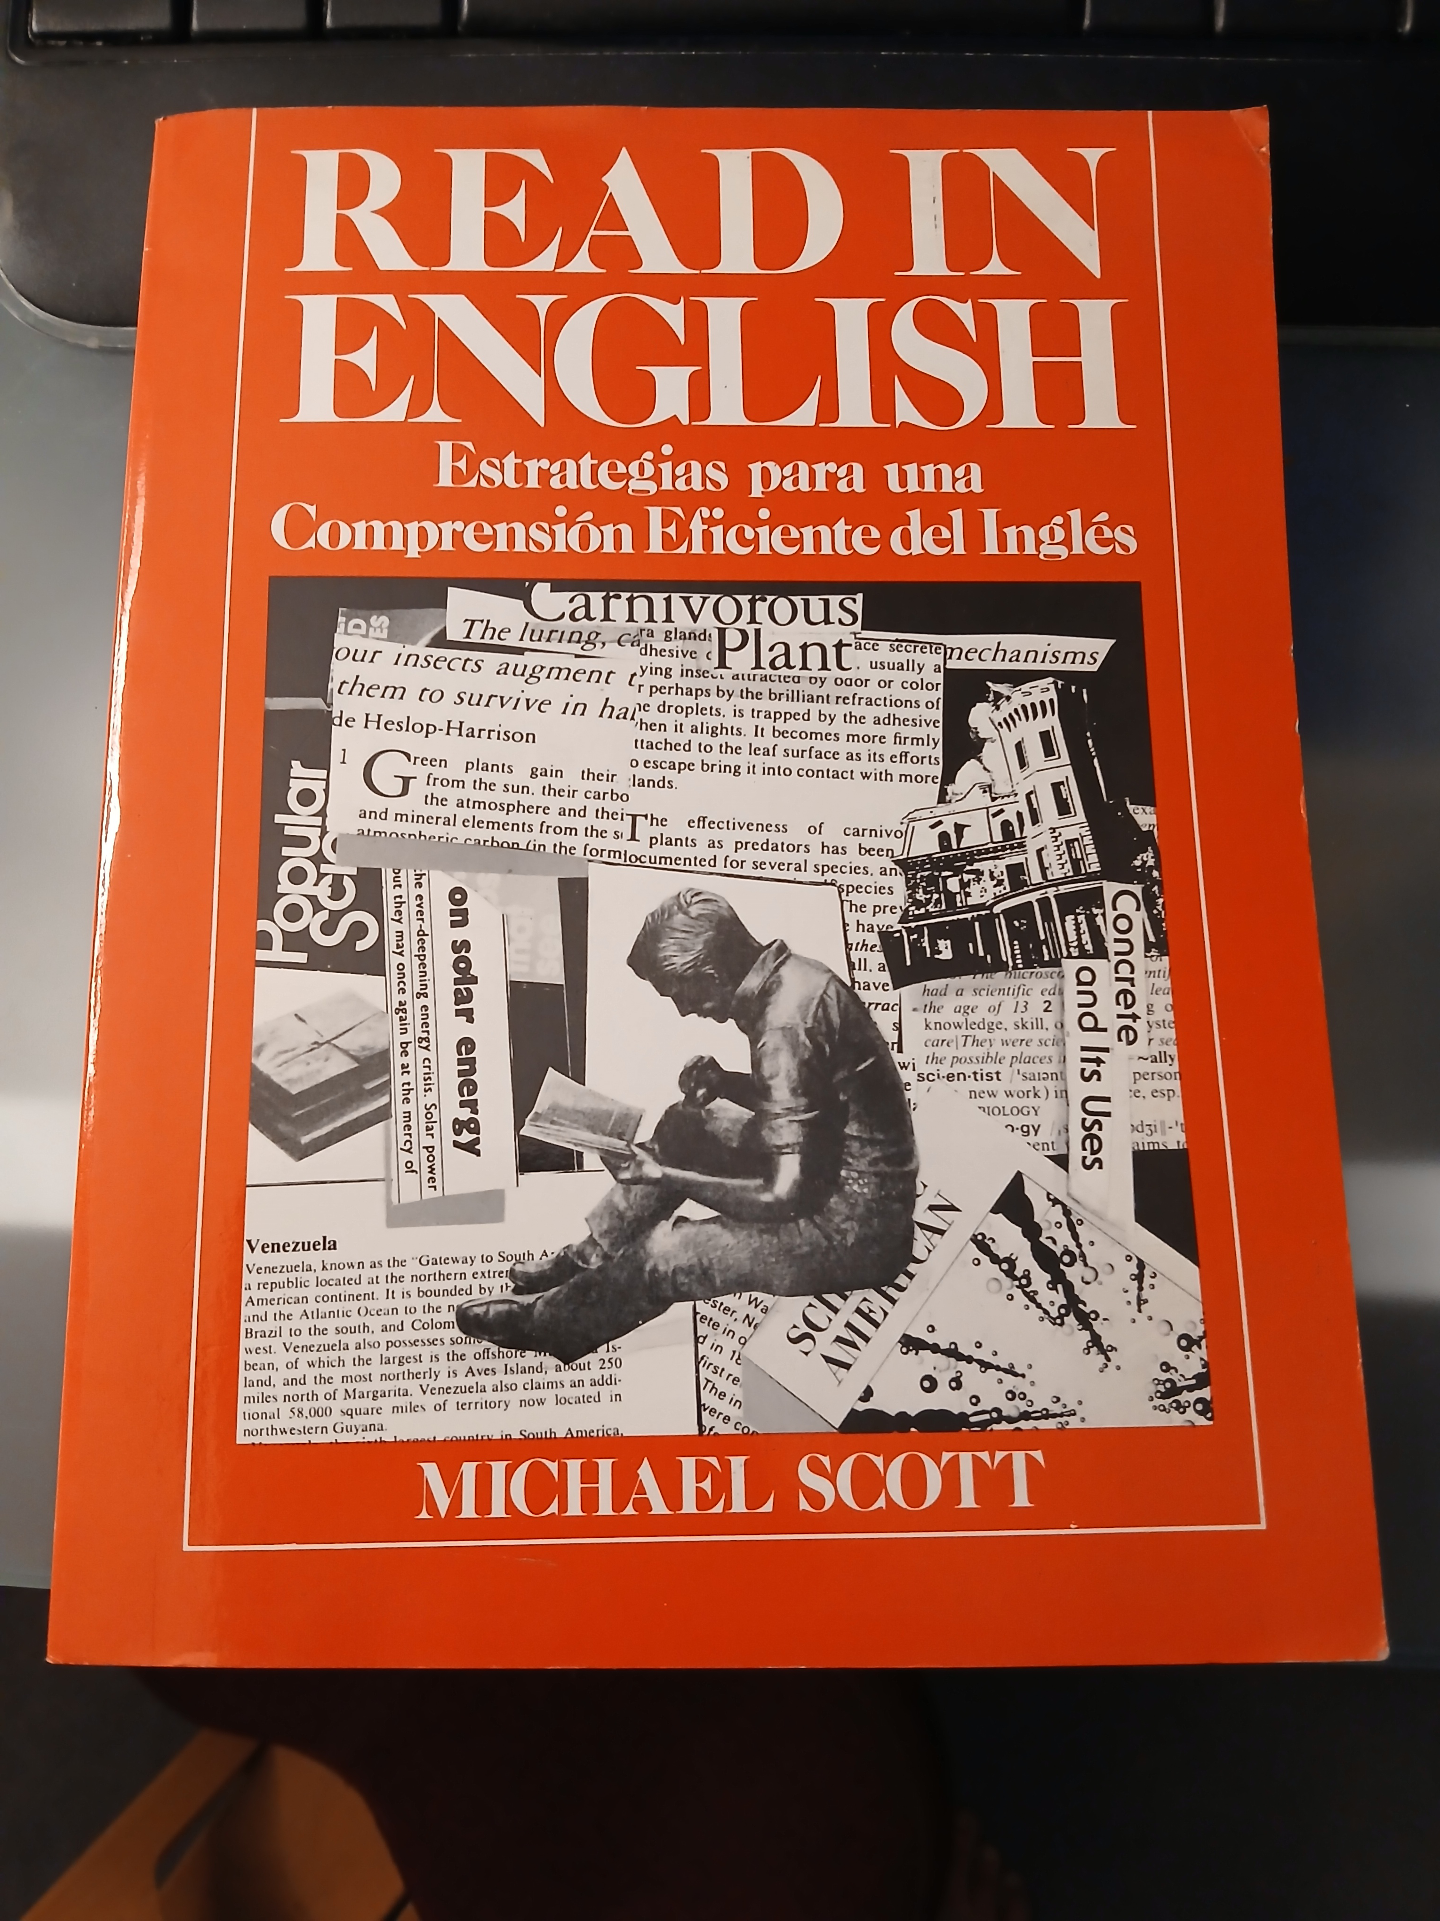
How keyness emerged (1)
Teaching reading in Mexico (1970s)
and Brazil (1980s)
Mexico: Sistema de Instrucción Personalizada
Brazil: Projeto Nacional de Inglês Instrumental

Slide 11
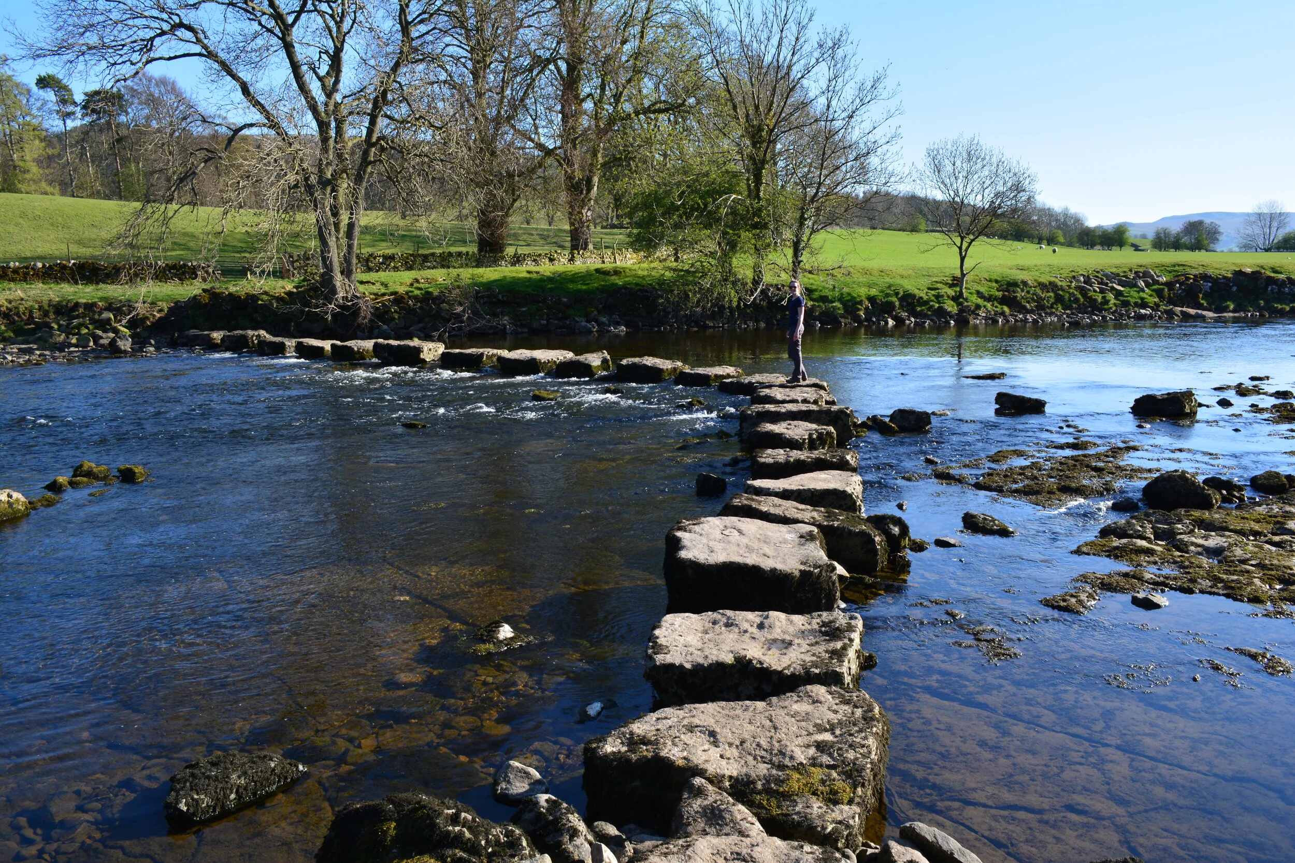
How keyness emerged (2)
my focus on main points
  avoid over-emphasis on unknown words
  avoid over-emphasis on detail
  repetition
  guessing/inference
  skimming
  cross the river using stepping stones
    coping strategies

Slide 12
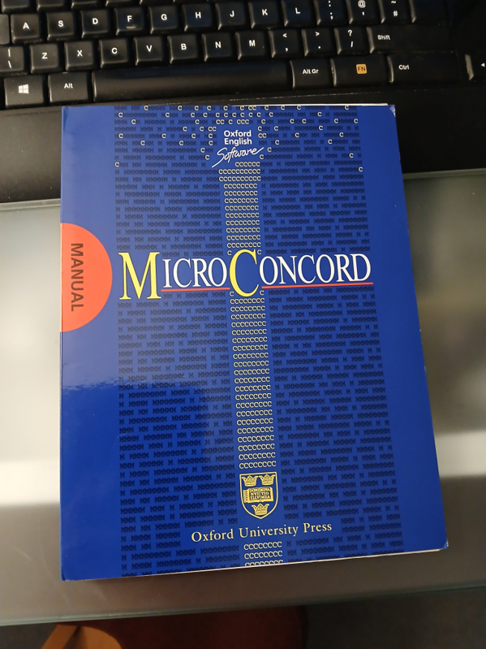
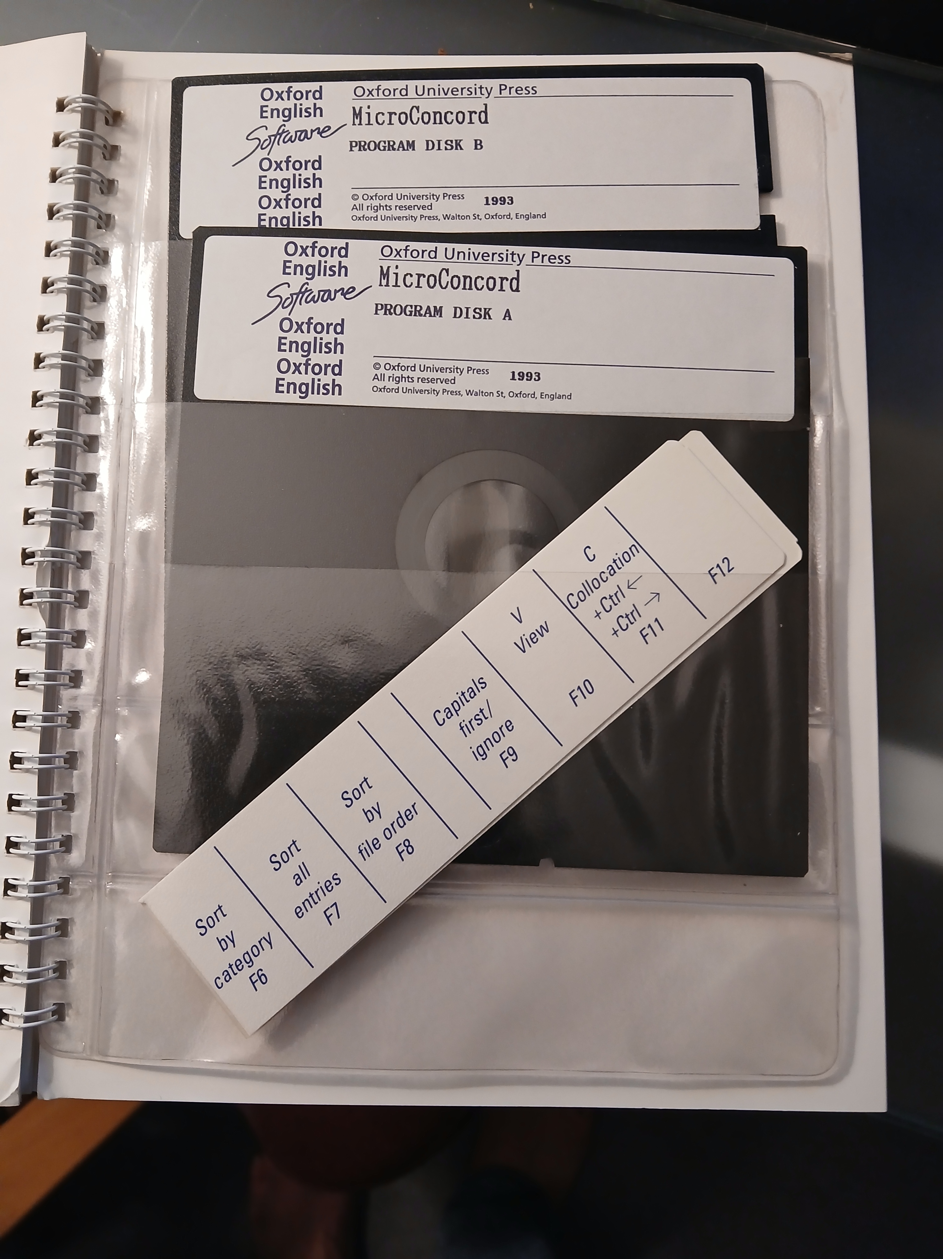
MicroConcord 1993
5.25” floppy disks
card for function keys

Slide 13
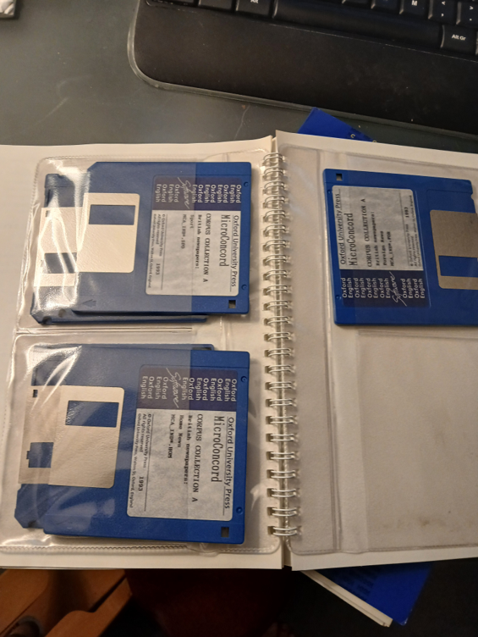
Corpus collection

Slide 14
How keyness emerged (3)
MicroConcord (1993) – only concordancing
interest in word listing (Oxford Concordance Program (OCP), 1981)
Fadilah studying the repetition of lexis in her textbook
WordSmith Tools (1996)

Slide 15
Why keyness emerged
Focus moving away from
sentence grammar: morpheme, word, phrase, clause, sentence
to
functions: complain, describe, narrate, advise
to
a textual view: text sections, text types, studies of specific corpora, key words
… back to main points!

Slide 16
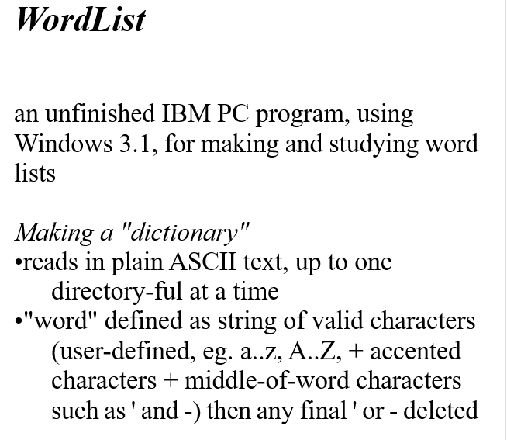
handout from October 1993:

Slide 17
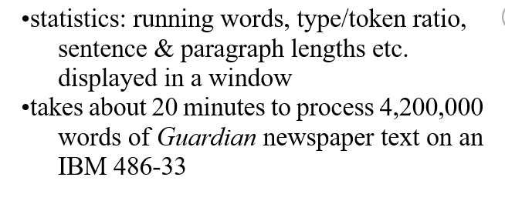

Slide 18
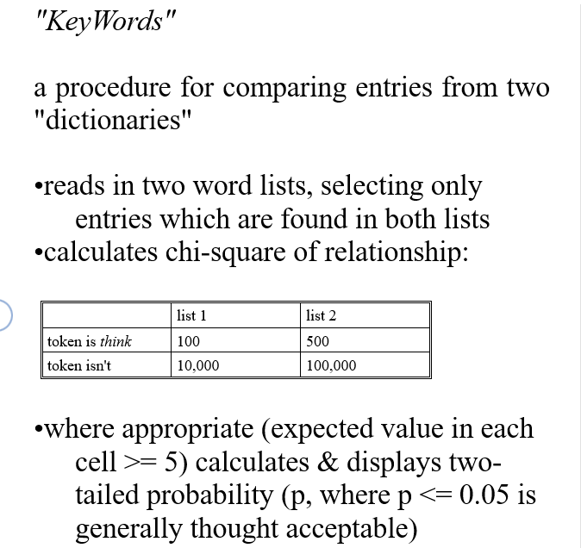

Slide 19
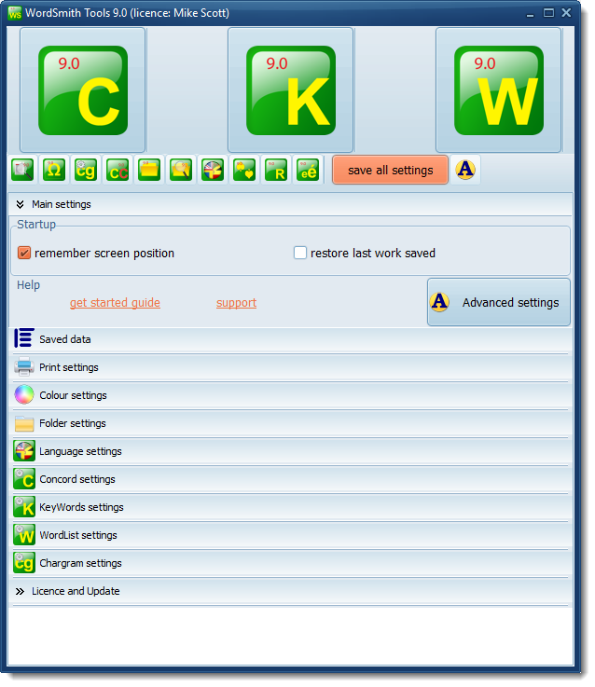
Current keyness-related corpus activity
WordSmith now in version 9.0
updated every couple of weeks
same 3 main Tools as in 1996

Slide 20
Collaboration
Reiner Grundmann (Nottingham)
climate change
nuclear energy
austerity
currently AI
cf Grundmann & Scott 2026

Slide 21




working with standard text databases
Large numbers of texts e.g. news articles
Problems:
  redundancy
  repetition
  relevance
Wanting to study corpora which truly relate to research topic

Slide 22
Duplicate contents method
filters based on date, folder, size of text file
then identification of some n-character strings in text A
and search for identical strings in text B
a test string starts at an exact character position
and includes spaces, punctuation etc
e.g. sed on date, folder, size of tex

Slide 23
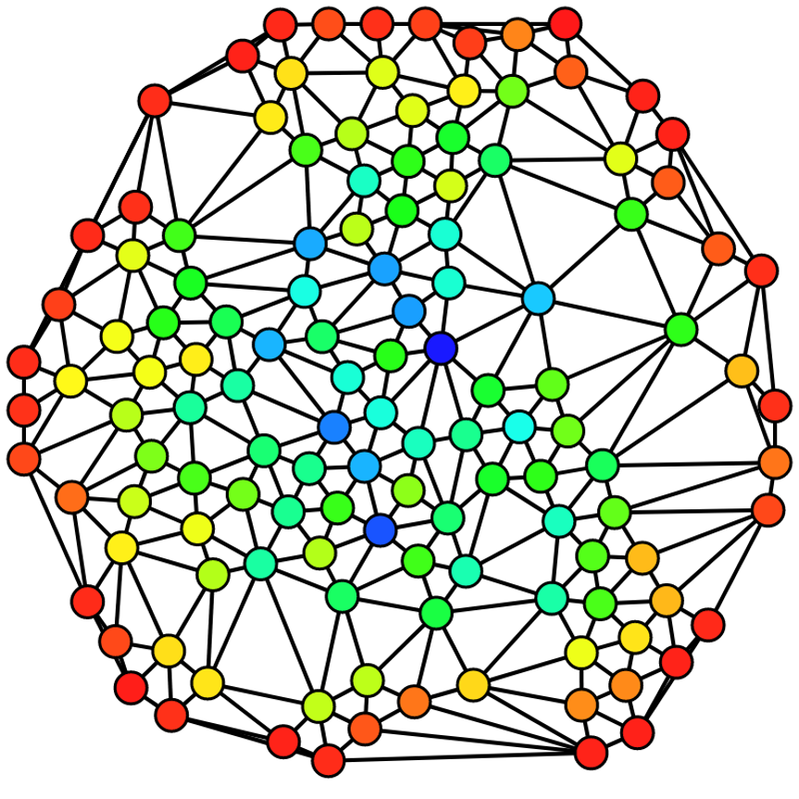
what is relevance?
aboutness
centrality or “wholetextness” or WholeTextNess
connected to your research topic
skim read: usually evident

Slide 24
relevance method
use KeyWords on whole corpus
search each text for selected key words
attach a score to each hit
  + spread of the term in the text + location in first N words
rank the scores
analyse the range

Slide 25
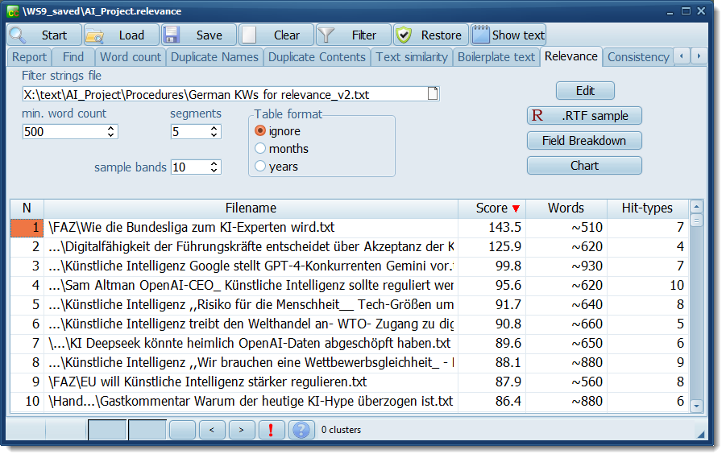
Relevance

Slide 26
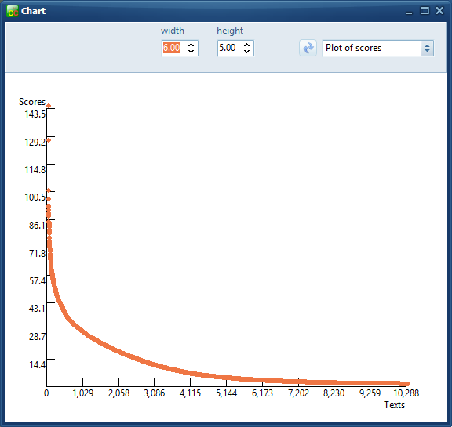
lots of low scores
texts which mention the search-term
few hits
or localised

Slide 27
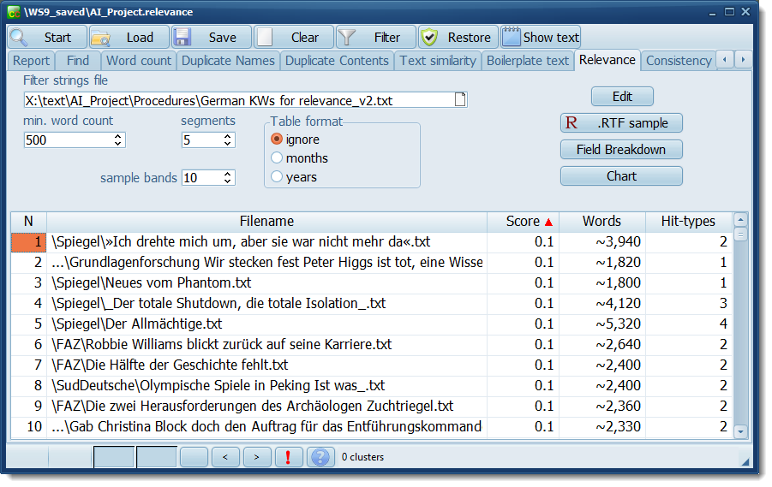
Irrelevance

Slide 28
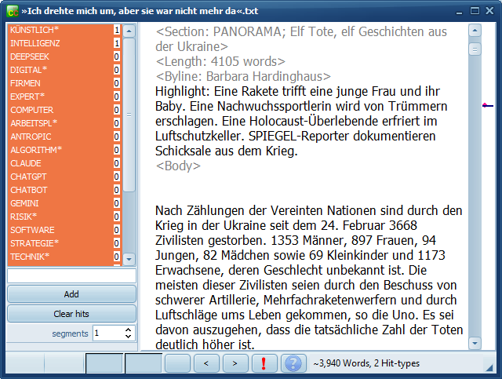
long text about Ukraine war,
AI, 1 hit

Slide 29
needs human checking
RTF sample procedure:
breaks the scores into 10 bands
show 5 texts in each band
with the KWs highlighted

Slide 30
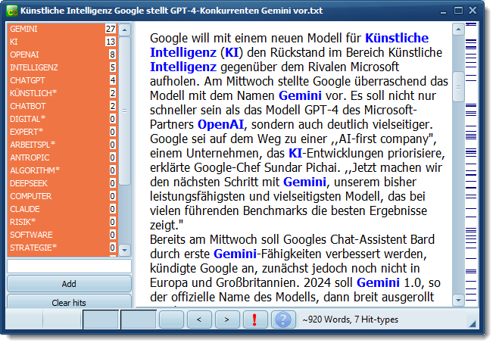

Slide 31
Biermeier, Thomas, 2024. Endonormative stabilization in Philippine English lexis, World Englishes. https://doi.org/10.1111/weng.12671
Grundmann, Reiner & Scott, M. 2026. Mapping the discourse of climate change in four western countries. Journalism. https://doi.org/10.1177/14648849261434292

